Slide 1

A Deep Analysis of Gun Violence in the U.S.
By Karan and Junming

Slide 2

Motivation
Over last 50 years, number of premeditated mass shootings & magnitude of each shooting has increased.
Ex. Columbine Shooting
We want to:
Explore issue of gun violence in America to uncover some potential truths
Obtain better understanding of the dynamics of gun violence in America
Notes:
Columbine shooting is a high profile school shooting near Littleton, CO in 1999
12 students and a single teacher were killed by two student perpertrators

Slide 3
Datasets
Gun Violence Data
Population Data
Includes
Gun violence incidents from 2013 to March, 2018
Each row represents record of a single incident
Source
Found on Kaggle
Structure
260k rows & 29 attributes
Includes
Information about the population in all states in 2017 along with District of Columbia
Source
https://www.enchantedlearning.com/usa/states/population.shtml
Structure
51 rows & 2 attributes (State & Population)

Slide 4

What are some trends associated with gun violence over time?
Number of Incidents over Year, Month, and Day
Number of Total Incidents (time series)

Slide 5
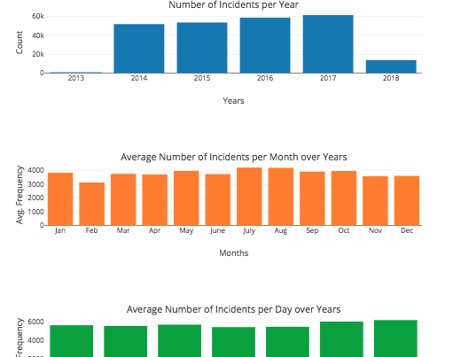
Incidents per Year
Upward rising trend from 2014 to 2017
Avg. Number of Incidents per Month
Most amount of incidents occur during the summer season (July and August especially)
Avg. Number of Incidents per Day
Weekends is most prominent

Slide 6
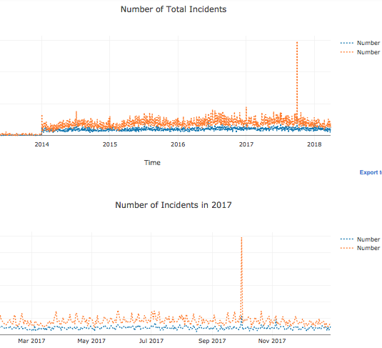
Number of Injuries > number of individuals killed
Large Peak in 2017
Outlier is Las Vegas massacre
Holiday trend (gun violence crimes increase during New Years, Christmas, 4th of July)
Notes:
Las Vegas shooting was a mass shooting on night of Oct 1st, 2017
Gunman opened fire on crow of concert goers at a music festival in the Las Vegas Strip in Nevada
59 died and over 500 injured

Slide 7
Could we explore some geographical patterns?
Top States and Cities with Highest Number of Gun Violence Incidents
Number of People Killed/Injured Across States
Population Adjusted
Most Serious Gun Violence Incidents

Slide 8
Notes:
-California is one of the top states with highest number of gun violence incidents
-Number of highest incidents seems to be Illinois

Slide 9
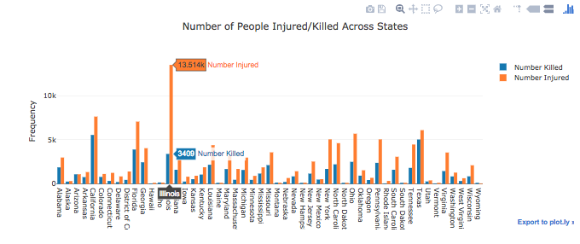
Notes:
-Number of Highest Injuries and Deaths is Illinois too
-Maybe this means that not only are there a frequent number of incidents in Illinois but the magnitude of the incidents is far worse
-Is this valid?

Slide 10
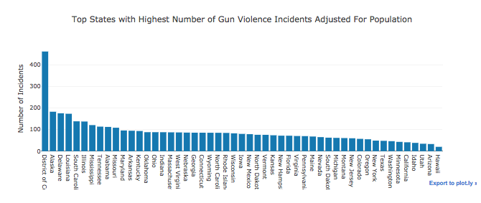
Notes:
Adjusting for population (we kept it constant for all the years), its surprising to see DC w/ most number of incidents
You would think that since DC is our capital, it wouldn’t be number one but it is. It has some of the most secure gun laws in the nation
Its also interesting that in terms of states, Alaska ranks first
Finally, notice the positions of Illinois from before as well as California

Slide 11
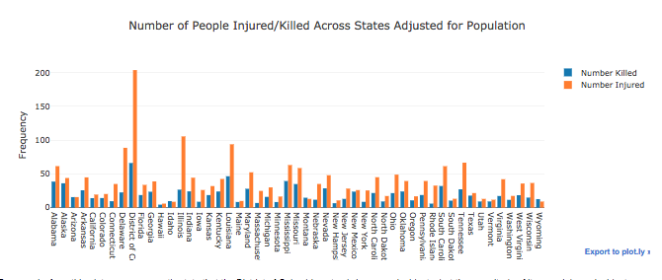
Notes:
-Not only does DC have a higher incident ratio , the magnitude of its incidents are higher
-Discuss Illinois & how its magnitude of violence is still detrimental

Slide 12
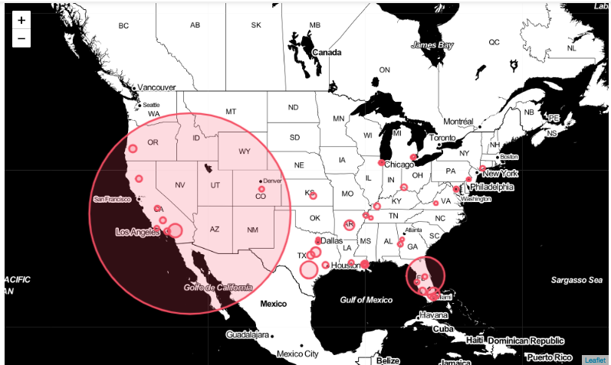
Notes:
-Las Vegas, Nevada 2017 → 548 total damage
-Orlando Florida → 103
-Surtherland Springs, Texas → 47

Slide 13

Characteristics of People involved in Gun Violence
Age Distribution of Victims and Suspects
Gender Distribution of Victims and Suspects

Slide 14
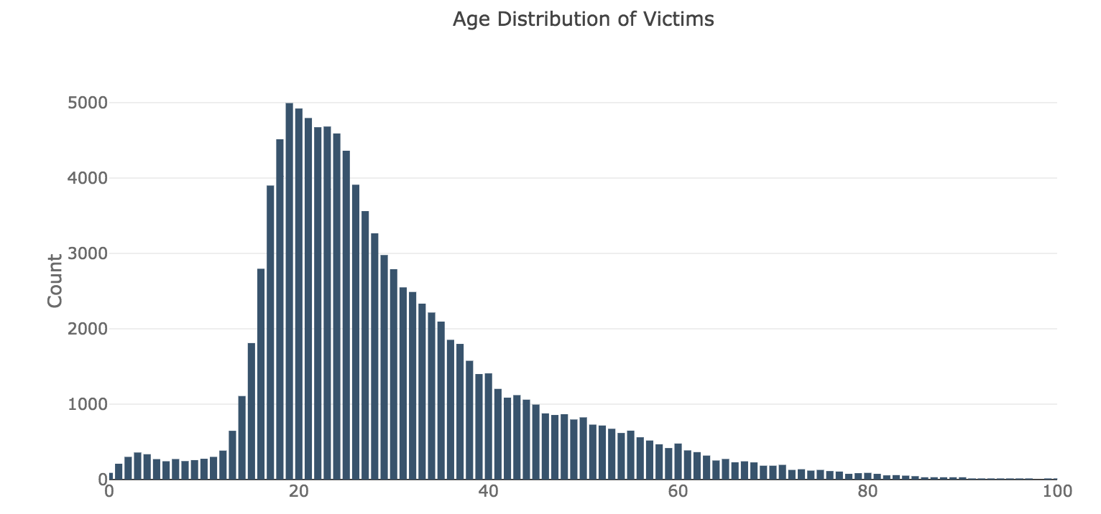
Age Distribution of Victims
19

Slide 15
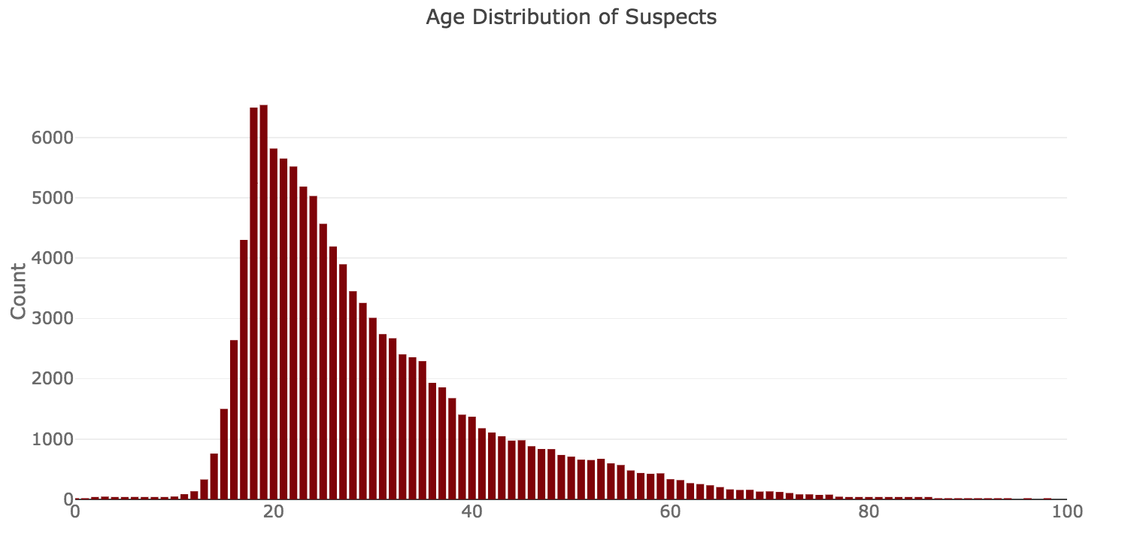
Age Distribution of Suspects
19

Slide 16
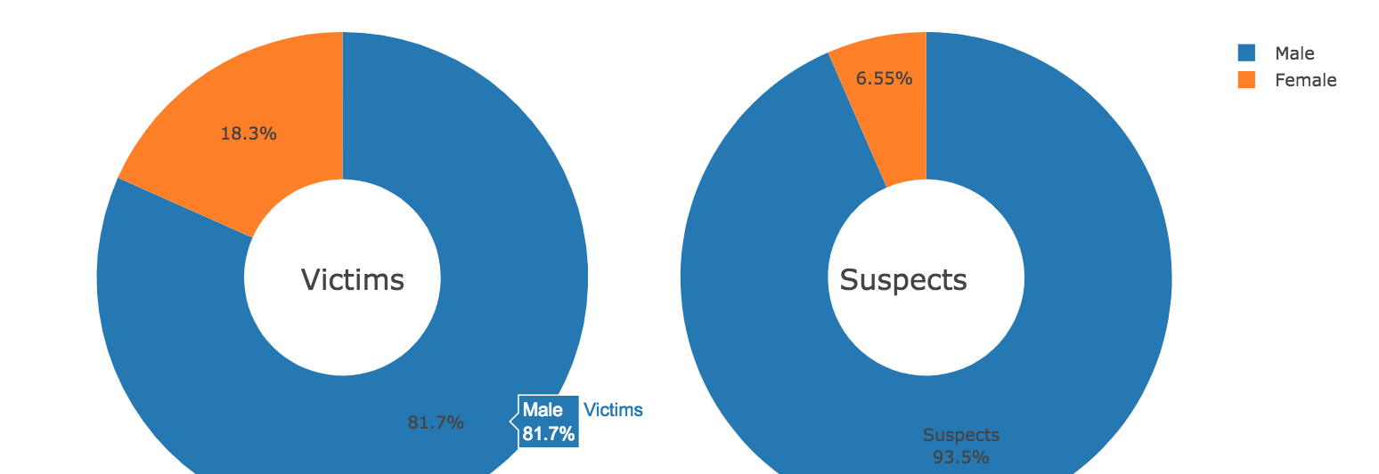
Gender Distribution of Victims and Suspects

Slide 17
Characteristics of Guns involved in Gun Violence
1
2
3
4
The Most Used Guns
Guns that Caused the Most Total Loss
Guns that Caused the Most Average Loss
Distribution of Incidents Involved among Different Types of Guns

Slide 18
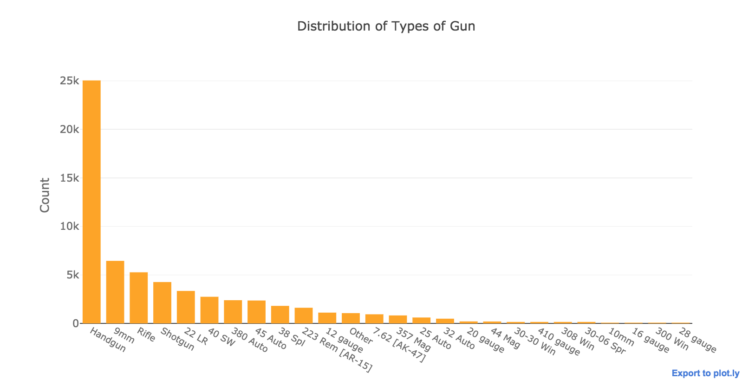
The Most Used Guns

Slide 19
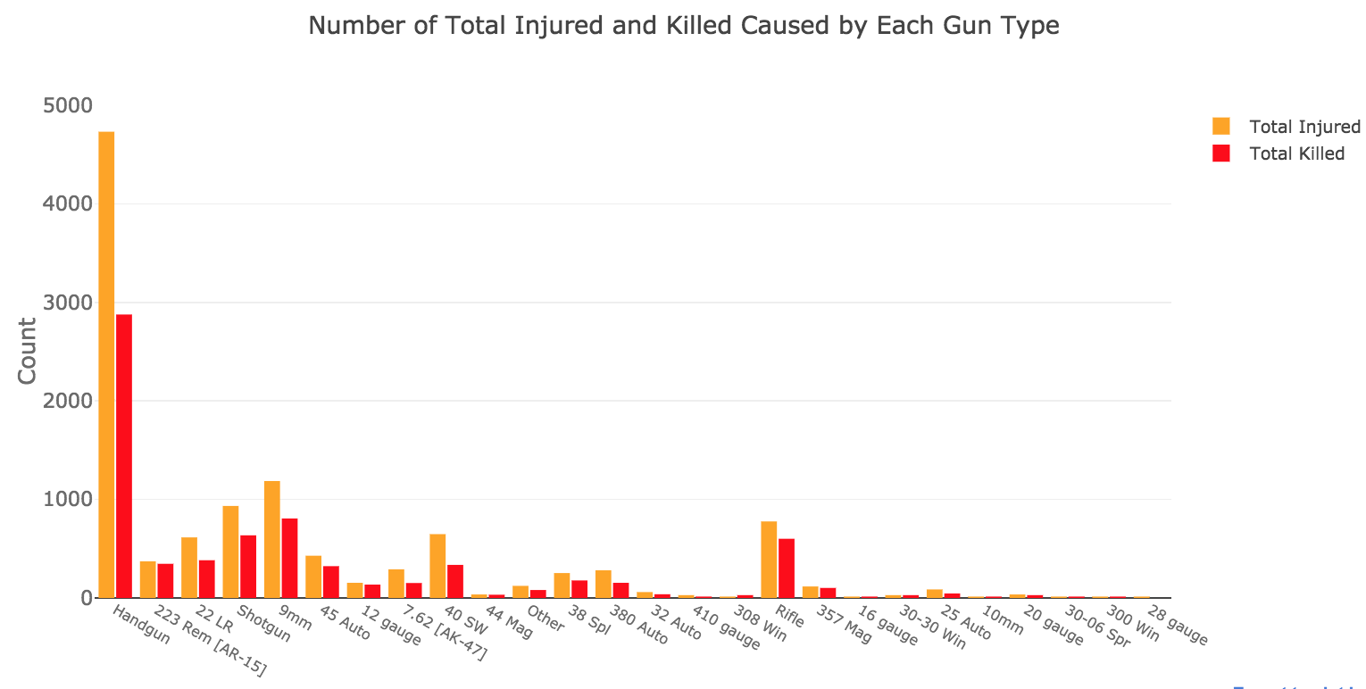
Guns that Caused the Most Total Loss

Slide 20

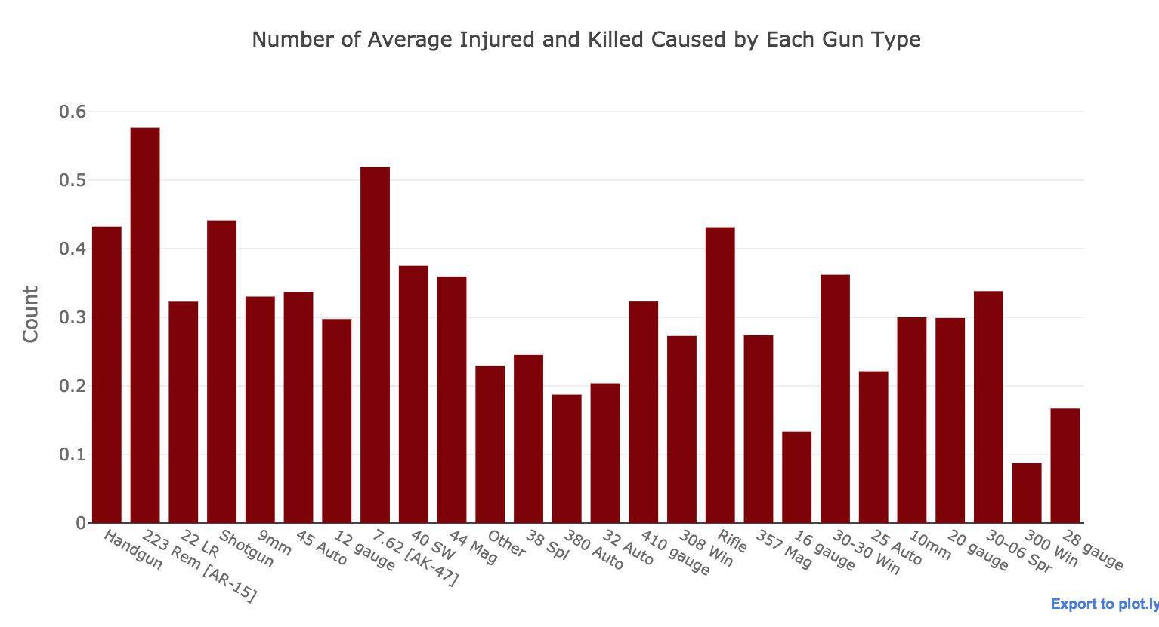
Guns that Caused the Most Average Loss

Slide 21

Why Different Guns Have Different Average Loss?
Is it because certain types of guns involved more in dangerous incidents,like mass shooting and drug involvement?
Or just because it is more harmful?

Slide 22
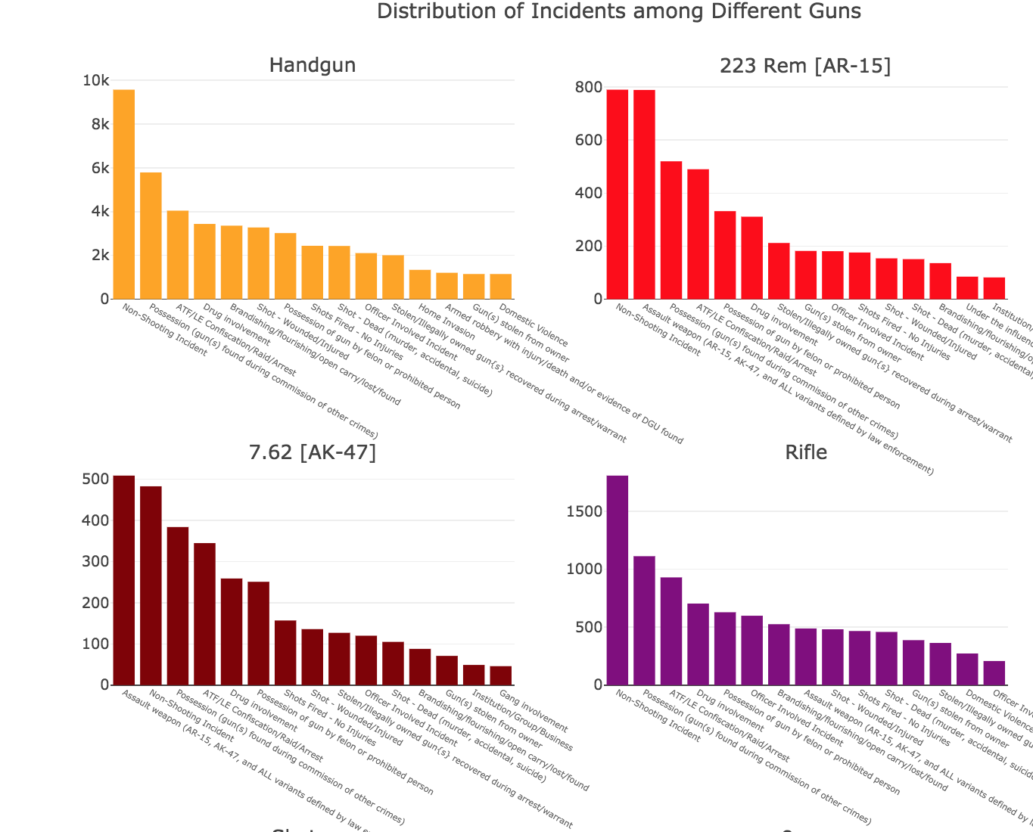
Do Different Types of Guns Indicate Different Incidents?
1.Non-Shooting Incident
2.Procession
3.Drug Involvement
4.Illegally owned during arrest

Slide 23


Conclusion
We conclude that gun violence incidents are increasing but magnitude relatively same
Gun violence has increased from 2014 → 2017
Aside from largest gun violence massacre in 2017, other massacres are relatively same in damage
More injuries than deaths
Additional gun violence demographics
Most victims and suspects are aged between 18 and 30
Most of the suspects are male
The most common type of guns is handgun
The most dangerous gun is AR-15 and AK-47
The distributions of incidents for each gun are similar
Alarming yet Interesting
District of Columbia has the highest number of gun incidents (though its our capital)

Slide 24

THANK YOU!

